Slide 1

An International Approach to Advancing Research Cultures
James Morris
Science Europe
12 May 2025
All-Island Research Culture Network Conference, Belfast
james.morris@scienceeurope.org

Slide 2





































Science Europe Membership
Science Europe comprises
40 Member Organisations
in 30 European countries
funding approximately
€25bn of research per year.
RESEARCH FUNDING ORGANISATION
RESEARCH PERFORMING ORGANISATION
www.scienceeurope.org

Slide 3

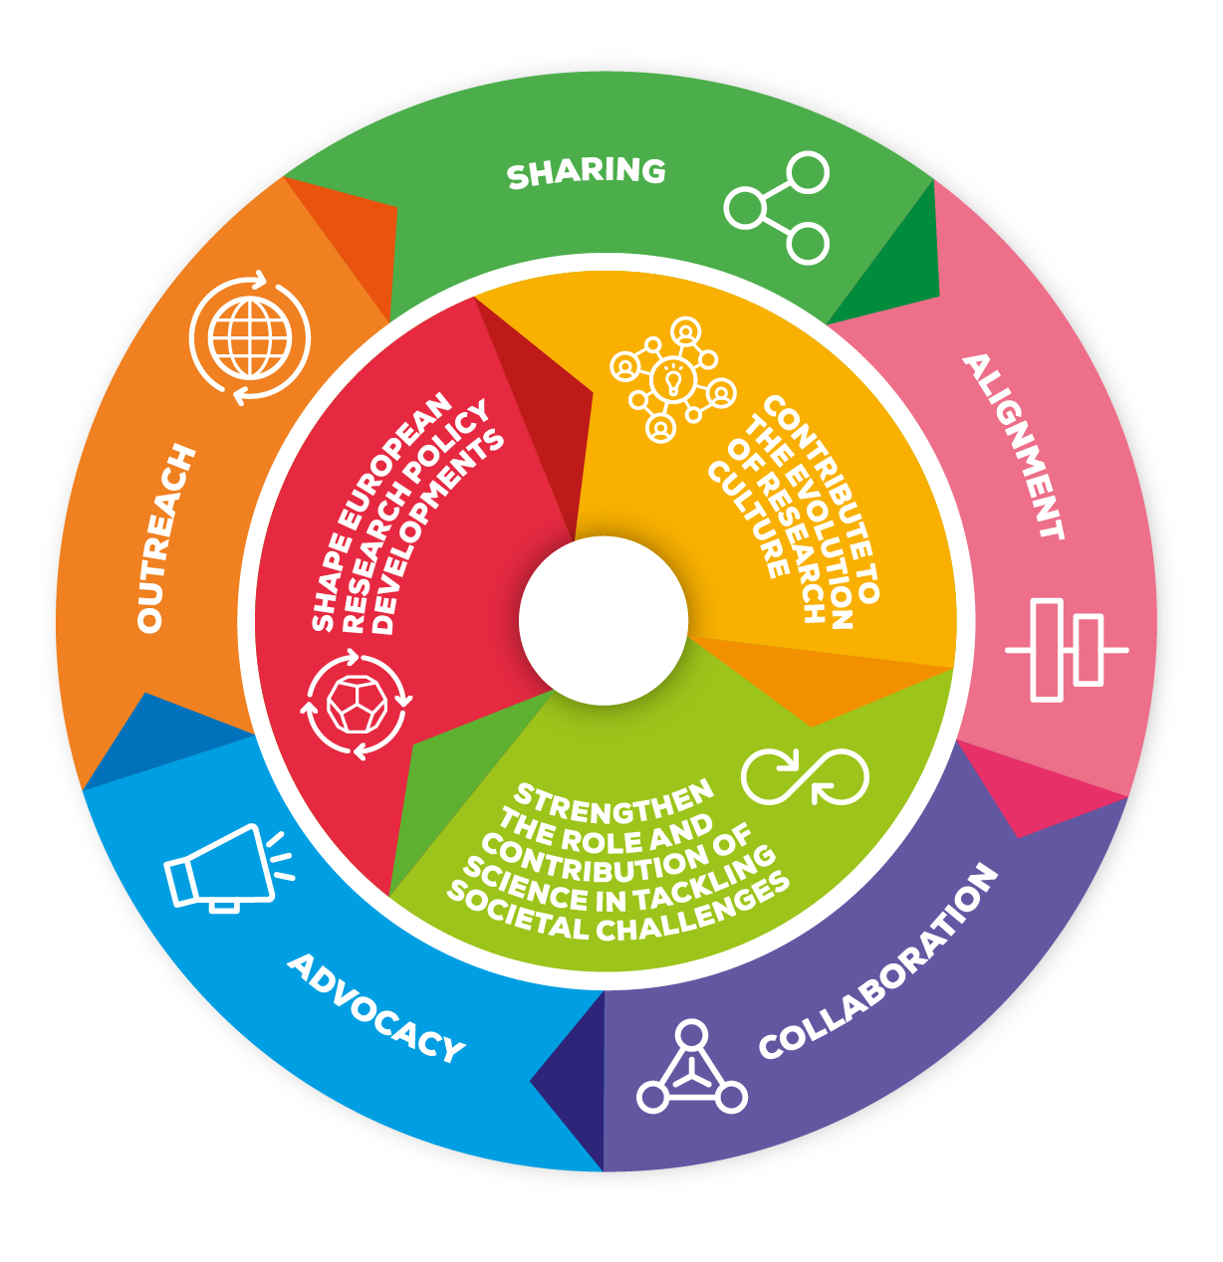


Science Europe’s Strategic Priorities
www.scienceeurope.org

Slide 4
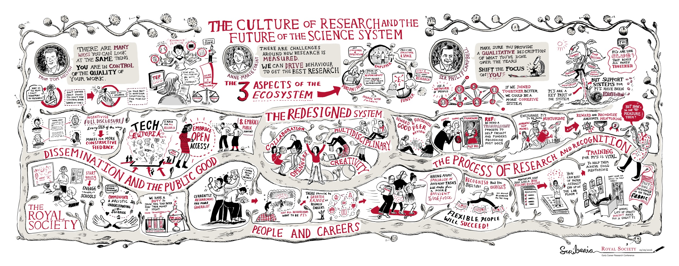
What we mean by ‘research cultures’
https://royalsociety.org/topics-policy/projects/research-culture/changing-expectations/visions-of-2035/

Slide 5
What we mean by ‘research cultures’
Team dynamics
Institutional environments
International collaboration
Individual perspectives
National systems
Behaviours
Attitudes
Actions
Practices
Policies
Missions

Slide 6
What we mean by ‘research cultures’
Team dynamics
Institutional environments
International collaboration
Individual perspectives
National systems
Values
Behaviours
Attitudes
Actions
Practices
Policies
Missions

Slide 7
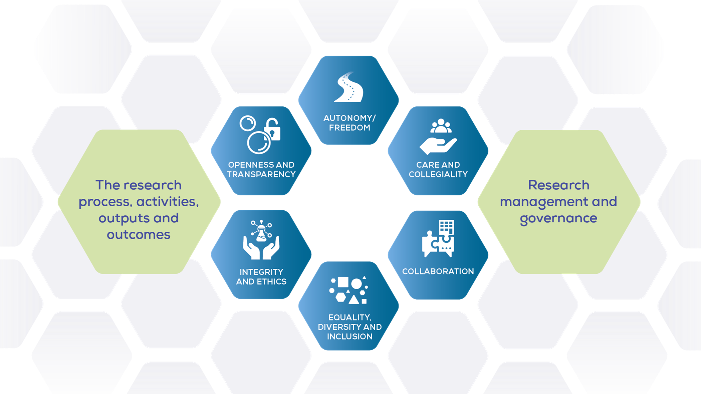
A values-based approach to research cultures
Ensuring that values at the heart of our research systems are reflected in policies and practices.
www.scienceeurope.org

Slide 8
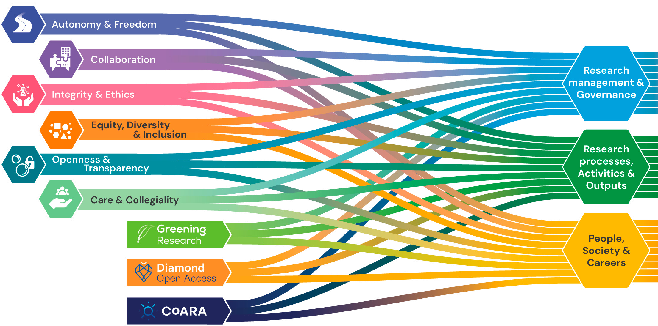
A values-based approach to research cultures
Bringing policy topics & priorities together to promote healthy & effective research cultures
https://scienceeurope.org/our-resources/a-vision-framework-for-research-cultures/

Slide 9

A values-based approach to research cultures
…all in support of research quality & knowledge advancement
https://scienceeurope.org/our-resources/a-vision-framework-for-research-cultures/

Slide 10

A Vision & Framework for Research Cultures
A set of 8 goals are presented as part of a comprehensive vision to guide further action over the coming decades: goals aimed at; attractive careers in research, diverse representation, open and inclusive science, rigor, and more. As our research system evolves ever quicker, it is vital to remain grounded in shared values and develop long-term perspectives.
Alongside our Vision, a supporting framework sets out conditions and to enable effective action, and Science Europe makes several commitments to act and support actions.
https://scienceeurope.org/our-resources/a-vision-framework-for-research-cultures/

Slide 11
Tracking progress & building evidence
Provide a shared direction for change.
Map and support good practices, pilots, and initiatives.
Work with relevant stakeholders to ensure a collaborative approach to advances.
Coordinate and ensure a research culture perspective to policy priorities.
Track progress qualitatively.
https://scienceeurope.org/our-resources/a-vision-framework-for-research-cultures/

Slide 12

Tracking progress & building evidence
What does culture change look like?
An example: Research Data Management
Objective: Encourage the FAIR sharing of research data
Mission: Research rigor, impact, quality etc…
Action: Mandate Data Management Plans + provide templates, guidance, examples etc.
Result: Increase in data management plans / data sharing /
Change in behaviour
Impact: Change in attitude? Shift in values? Different approach to other open science activities?
https://scienceeurope.org/our-priorities/open-science/research-data-management/

Slide 13
Tracking progress & building evidence
Key considerations for tracking the evolution of research cultures:
Think qualitatively, and at an aggregate level
Allow for- and promote flexible approaches whilst considering alignment, when beneficial
Consider actions on different time-scales and of different scopes
Do not add unnecessary burden
Consider possible side-effects and unwanted consequences
Embed community feedback and self-evaluation processes
Ensure that tracking and evidence-building processes, themselves, are aligned with shared values
https://scienceeurope.org/our-resources/a-vision-framework-for-research-cultures/

Slide 14



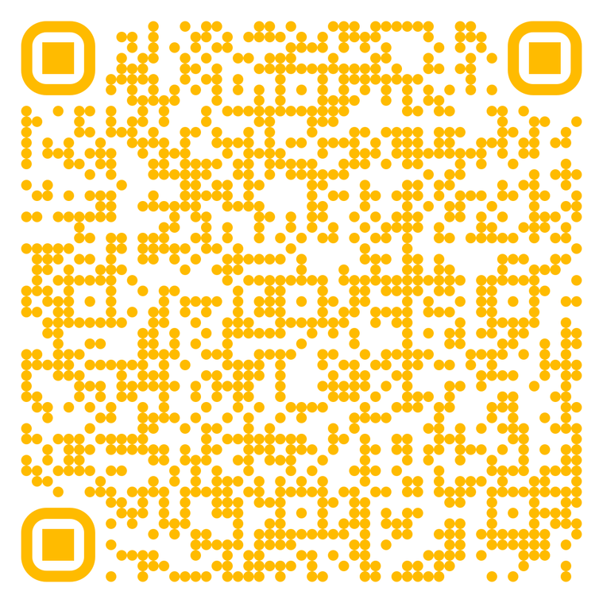

Scan the QR code to access the position statement and stay up-to-date with our research culture activities.

Slide 15
Thank you for your attention
james.morris@scienceeurope.org.

